Slide 1
Eating Dark Chocolate While Watching Paul Holmes’ Apology
By Karlo MIla

Slide 2
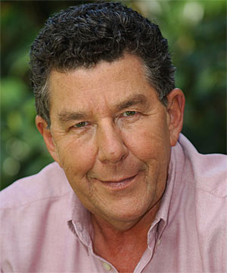
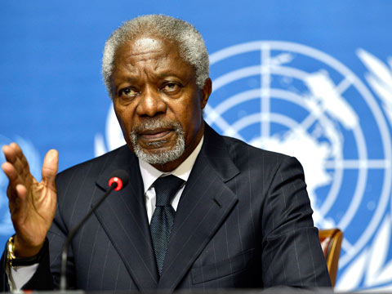
Context
In 2003 Paul Holmes called UN (United Nations) secretary general Kofi Annan a “cheeky darkie” for his criticism of the US intervention in Iraq.
http://www.youtube.com/watch?v=nNdk7Hsj_R0

Slide 3
Backlash
A producer resigned in protest.
Sparked a public outcry both in NZ and overseas.
A group of over 50 academics signed an open letter for him to resign.
Holmes donated money to charity and formally apologised on television.

Slide 4
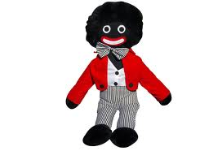
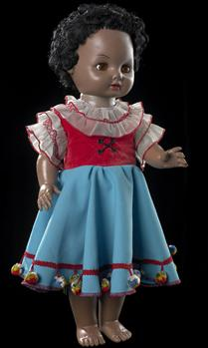
References in the poem
“we won the war in 1944!” – a popular chant. (WW2 actually ended in 1945 but then it wouldn’t rhyme!)
Golliwog – a black character in children’s books in 19th c.
Manu – doll featured on playschool – made of brown plastic

Slide 5
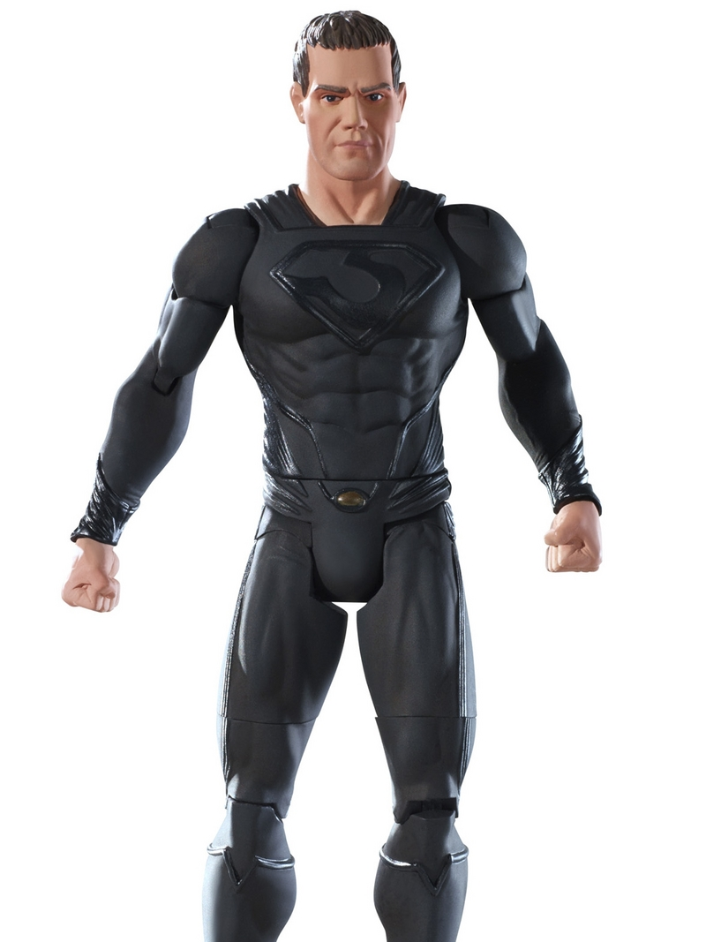
“Southern drawls”- Dialect/accent found in Southern US
“Lynching” – Hanging. Many supporters of African American rights were hanged in late 19, early 20th.
“Matlock” - An American legal drama. Matlock was a defence attorney
“Mattel man” - Strong looking action male action figure.

Slide 6
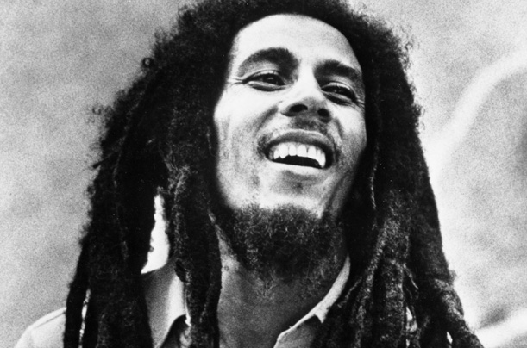
Bob Marley – Well known Jamaican musician.
“Indian Mayor of New Zealand” – Sukhi Turner. Mayor from ‘95-2004.
“Skinheads” – White supremist subculture
“anti pc” – pc= political correctness.

Slide 7
Mila reading poem
http://www.nzepc.auckland.ac.nz/pasifika/mila3.asp

