Slide 1
Effective Visual Text

Slide 2
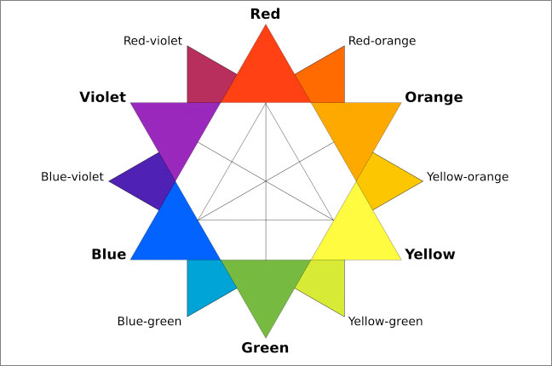
Colour wheel:
Analogous – Three colours next to each other
Complimentary – Colours opposite each other
Split complimentary – Colours almost opposite, i.e. Red and blue green
Triad – three parts of triangle, i.e. red, blue and yellow

Slide 3
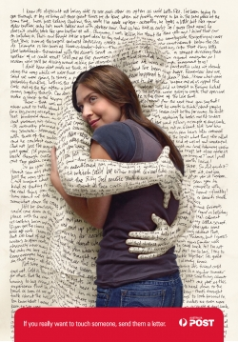
What is the message of this ad?
How is the image manipulated to convey this message?

Slide 4
How do colour and contrast reinforce the main message?
How is text incorporated into the ad?

Slide 5
How do font and colour connect with the product being advertised?

Slide 6
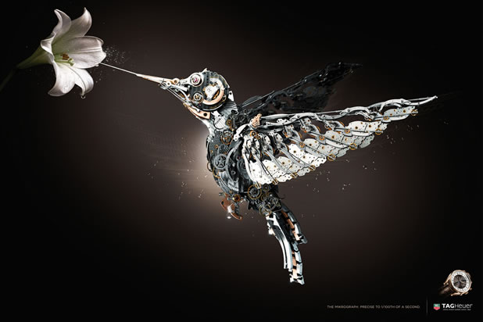
TAG Heuer is a watchmaker. How does this ad get across the detail and quality of their watches? How is lighting used to help this ad command attention?

Slide 7
This ad is selling Hoover vacuum cleaners. How is text incorporated into this image?

Slide 8
Another image that incorporates text well.

Slide 9
How are images used in a different way to convey the main idea?
How could text be incorporated into this image?

Slide 10
This ad is for the “come with a story and leave with another” campaign. How is negative space used to convey this idea? Which two characters can you find?

Slide 11
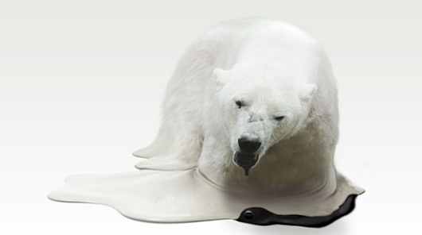
What is the message of this ad?
How is the image manipulated to convey the message?
How could text be integrated into this ad effectively?

Slide 12
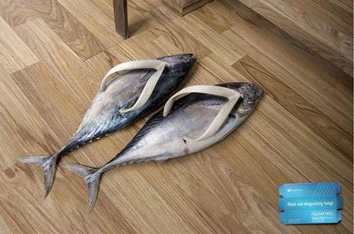
More effective manipulation of images.

Slide 13
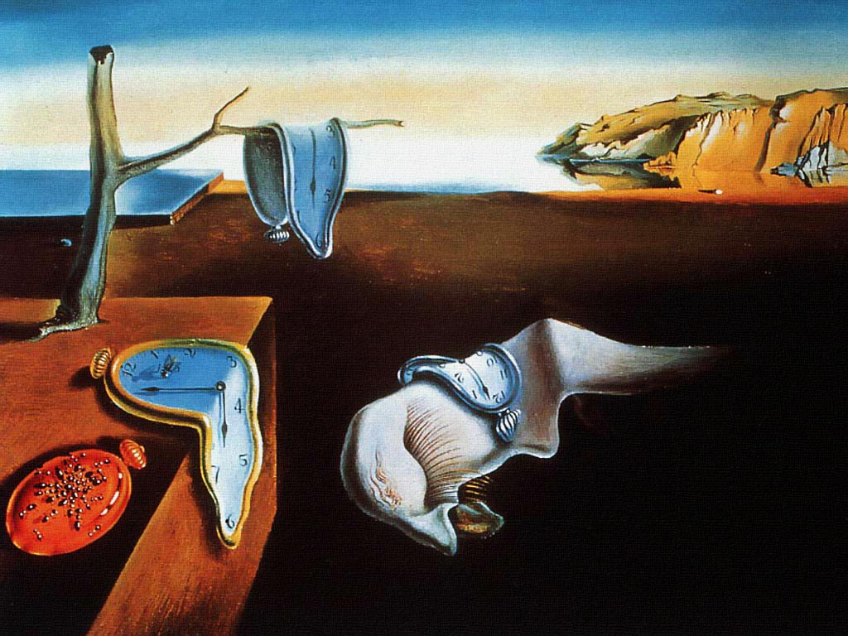
The Persistence of Memory – Salvador Dali How are the clocks manipulated to give the audience a different viewpoint of time and memory?

Slide 14
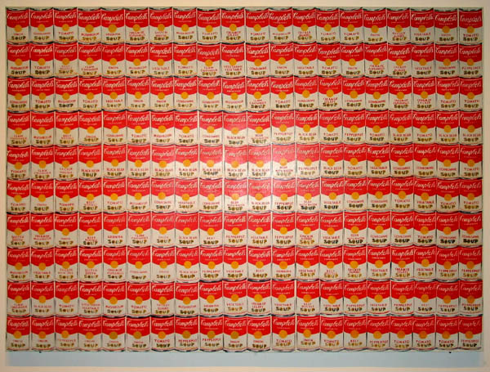
Soup Cans – Andy Warhol
How is repetition used in this image to comment on choice and sameness?
Do you think this work would have the same impact if only one large can was used? Explain.

Slide 15
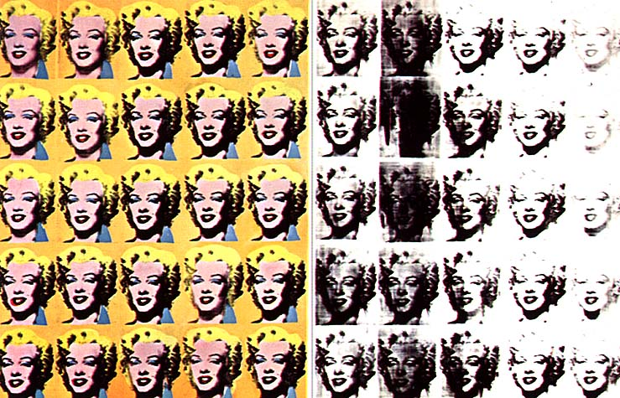
Marilyn Monroe – Andy Warhol
How is the repetition and degradation of Marilyn Monroe’s image a comment on US celebrity culture?

