Slide 1
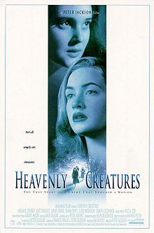
Heavenly Creatures (1994)
Directed by Peter Jackson
A little context

Slide 2
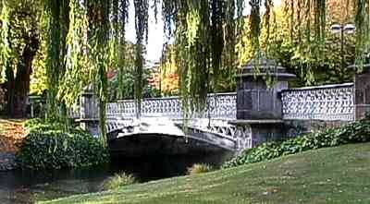
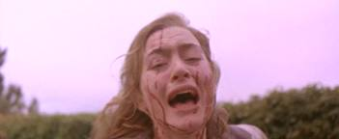
The Parker Hulme (not Hume!) Murder Case
On 22 June 1955 in Christchurch Honora Rieper went for a walk in Victoria Park with her daughter Pauline Parker and Pauline’s best friend Juliet Hulme.
After walking around 130 m down a path, Pauline and Juliet murdered Honora by bludgeoning her over the head with a brick in a stocking.

Slide 3
After the murder, the two girls ran back up the path, covered in blood, and claimed Honora had fallen and hit her head.
However, the brick was found quickly by the police, and their story quickly unravelled.

Slide 4
The Trial
Was a well broadcast with speculation regarding the girls’ lesbianism and insanity.
The girls were convicted on 28 August 1954 and spent 5 years in prison as they were too young to be considered for the death penalty.
Some claim they were ordered never to see each other again following their release, but this is not confirmed.

Slide 5
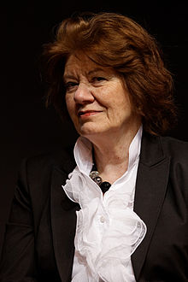
Following their Release
Juliet Hulme changed her name to Anne Perry, and began a successful career as a writer of historical detective fiction. She is now a Mormon
As of 1997, Pauline was running a childrens’ riding school in Kent, England. She is now a Roman Catholic.
Anne Perry

Slide 6
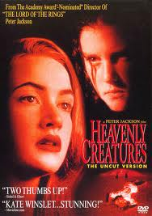
The Film
Written by Peter Jackson and Fran Walsh
Received strong critical acclaim
Though based on fact, the film should be regarded as a fiction
The main participants were not consulted, but several other people alive at the time were.
Jackson was meticulous about using actual locations and artefacts.

