Slide 1
Symbols and Motifs in Heavenly Creatures

Slide 2
Symbols – Things in the film that represent more than themselves. Eg. The blue and red pills.
Motifs – Repeated images that link to a main idea in the film. Eg. Telephones.

Slide 3
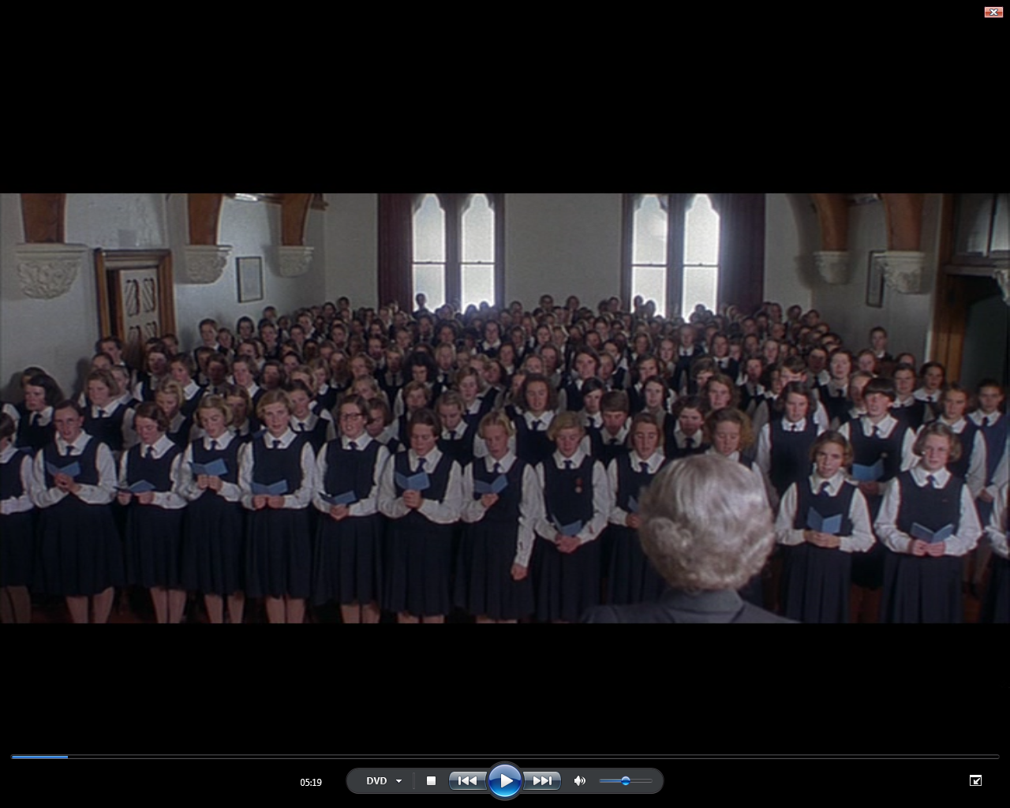
Just a Closer Walk with Thee - song

Slide 4
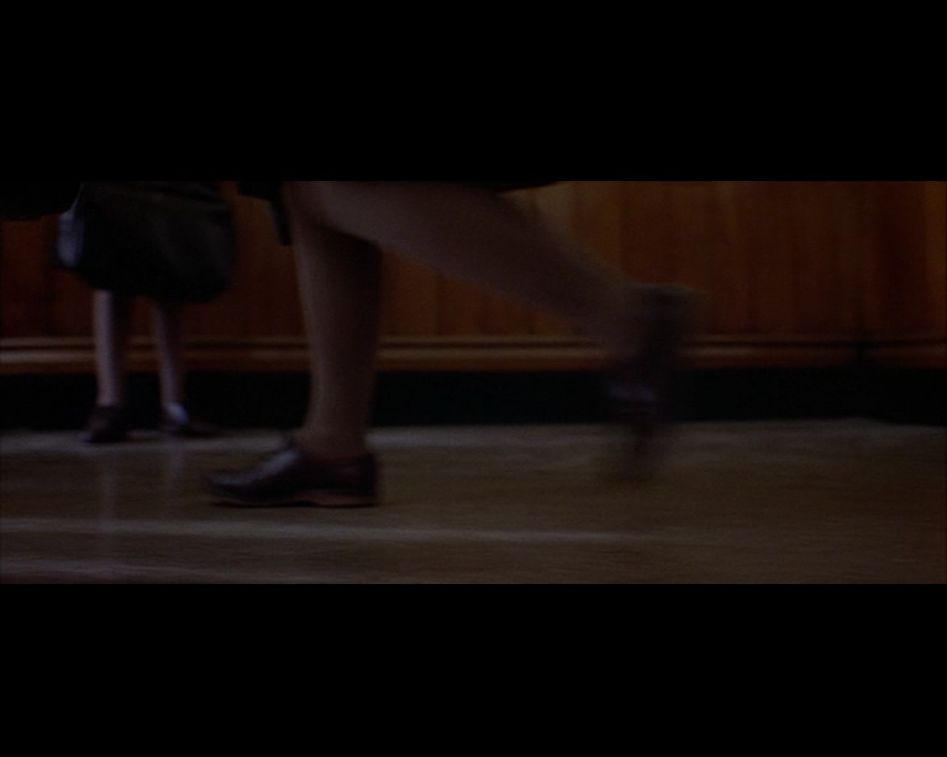
Legs and feet walking and running

Slide 5
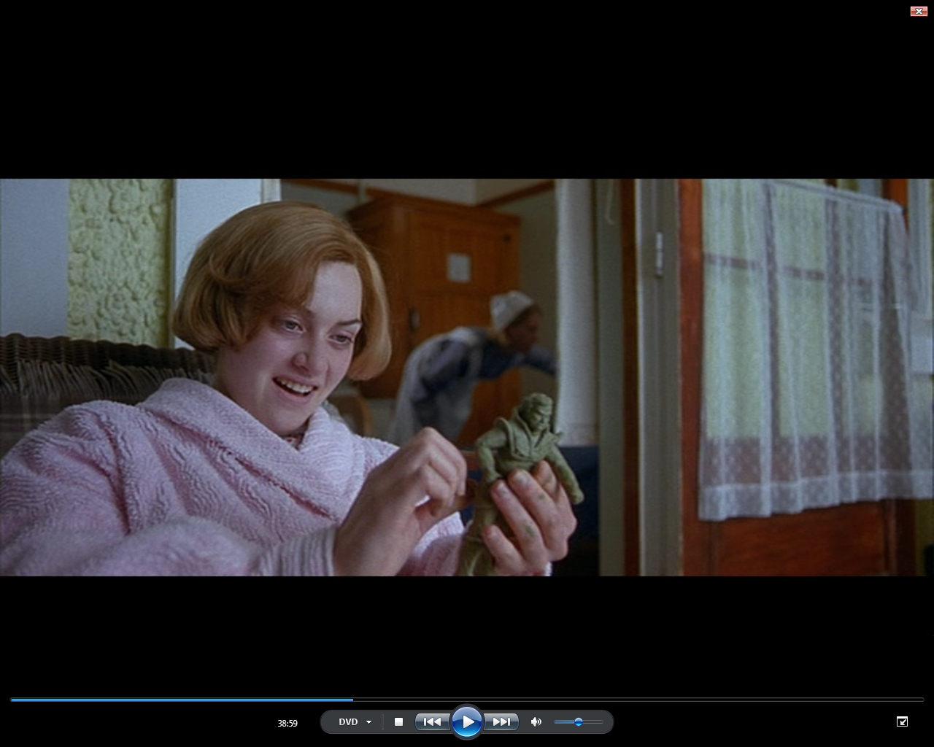
Hands writing and making things

Slide 6
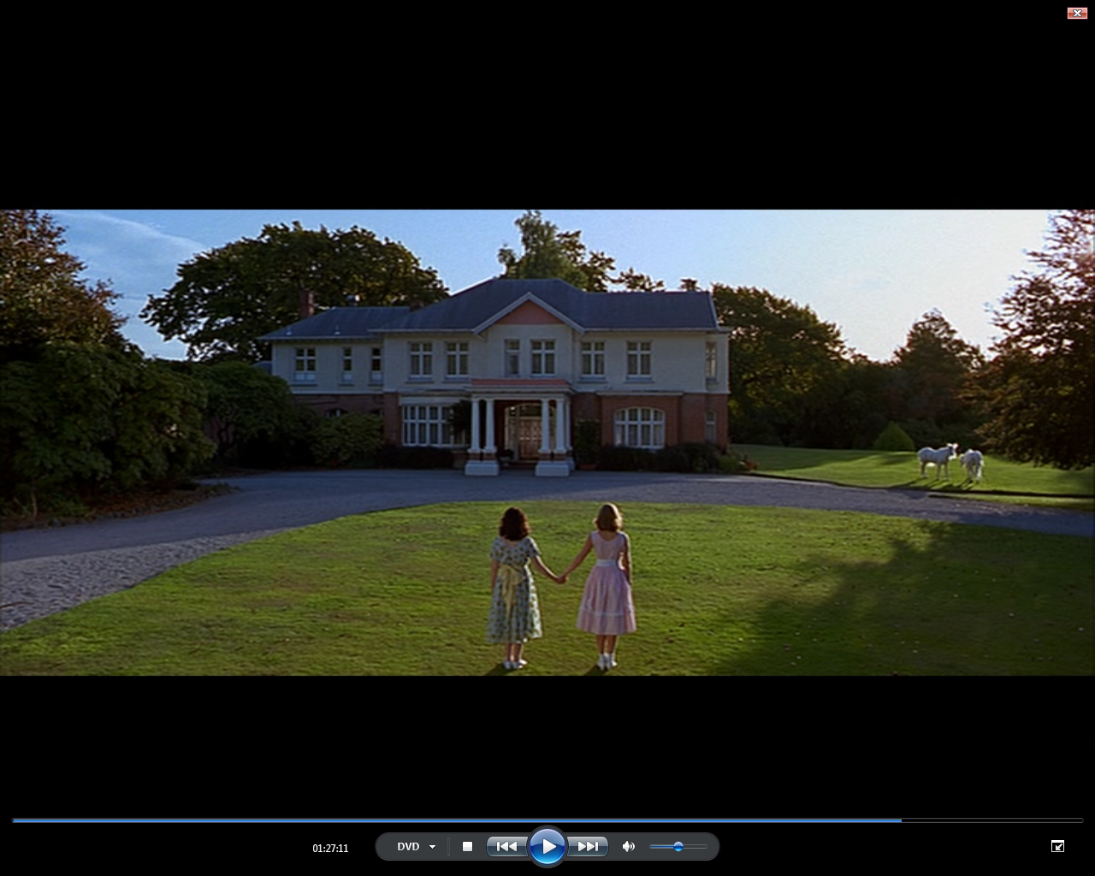
Horses and unicorns

Slide 7
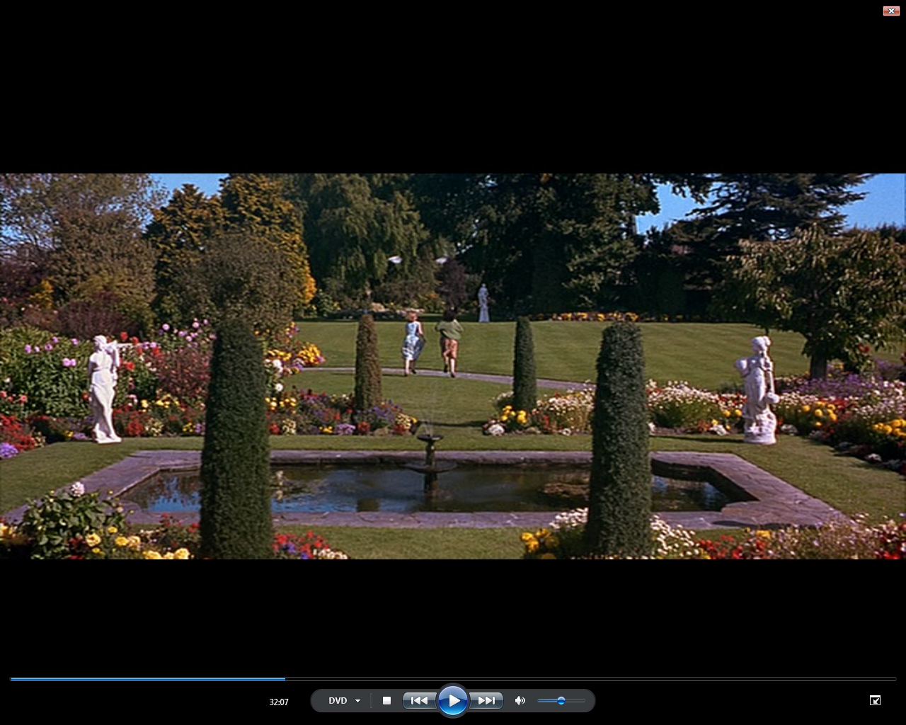
Birds

Slide 8
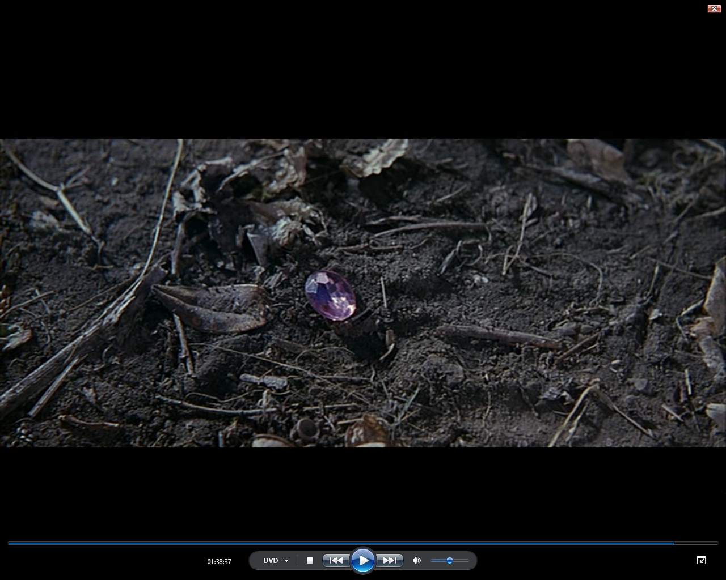
The pink jewel

Slide 9
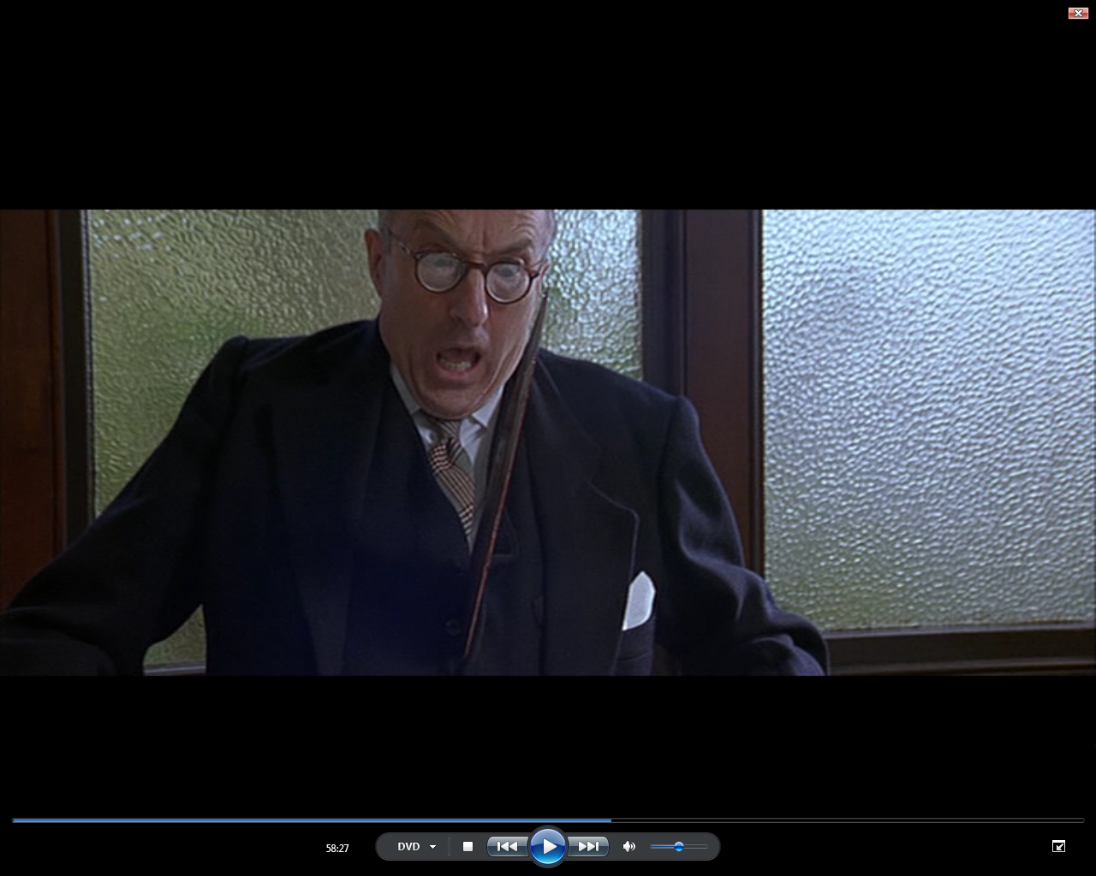
Knives, swords, guns and weapons

