Slide 1
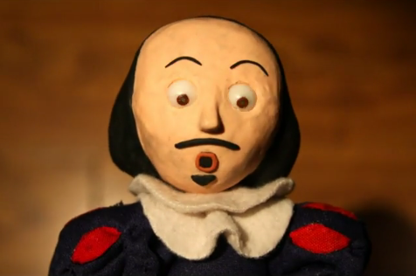
Hmm, Shakespeare, Why do I care for thee?

Slide 2
Words
Shakespeare wrote near the beginning of our modern English language. He invented 1,700 words and many phrases we use today.
Eg.
accommodation
aerial
amazement
apostrophe
assassination
auspicious
baseless
bloody
Phrases:
-All that glitters is not gold
-Brave New world
-Be all and end all
-Break the ice
-Dead as a doornail
-Eaten me out of house and home

Slide 3
Literature
The first and most obvious reason: The issues he deals with are the same we deal with.
He expanded dramatic use of plot, character, language and genre (history, tragedy, comedy). Eg. Before Romeo and Juliet, Romance was considered “unsuitable” for a tragedy.
Use of soliloquys to reveal characters’ minds.

Slide 4
Music
20,000 pieces of music have been linked to Shakespeare’s work
Dame Kiri Te Kanawa in “Otello” (Othello): http://www.youtube.com/watch?v=bDMiHSgTz7Q&feature=related

Slide 5
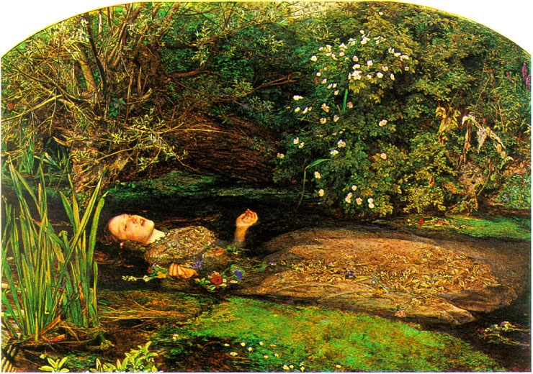
Art
“Ophelia”, Millais, Hamlet

Slide 6
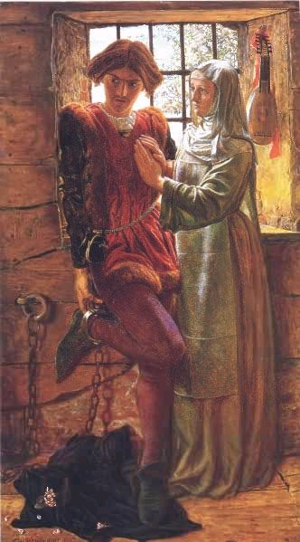
Holman Hunt, “Claudio and Isabella” from Measure for Measure

Slide 7
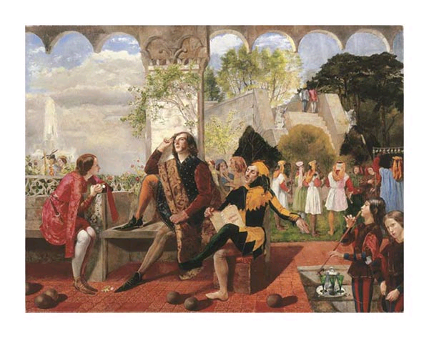
Deverell, Twelfth Night

Slide 8
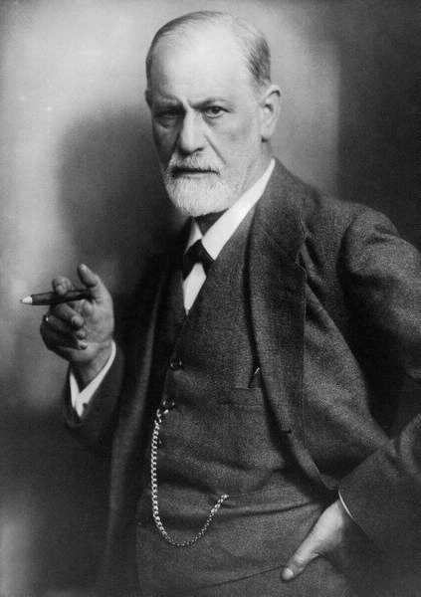
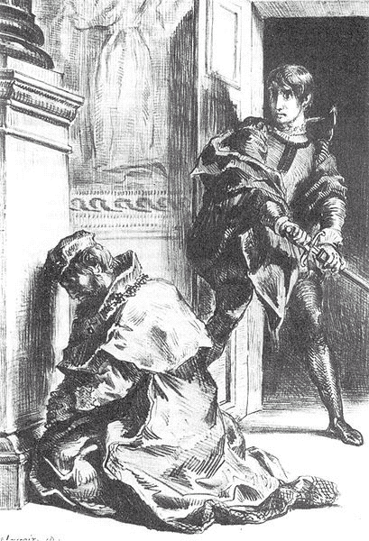
Psychology
Freud (1856 – 1939) developed field of psychoanalysis. Drew on Shakespeare for his theories.
Oedipus Complex – a boy’s unconscious desire to kill his father and sleep with his mother.
Freud argued this was the reason for Hamlet’s delay in killing Claudius. Claudius killed his father and took his place beside his father. He represents the Oedipus Complex present in Hamlet.

Slide 9
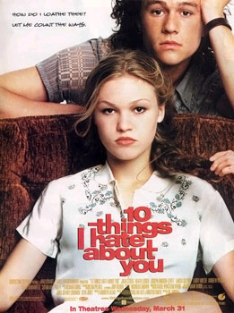
Film
Hollywood continues to make versions of the Bard’s plays. Eg.
She’s the Man (Twelfth Night)
Ten Things I Hate about You (Taming of the Shrew)
Romeo and Juliet (with Leo Dicaprio)

