Slide 1
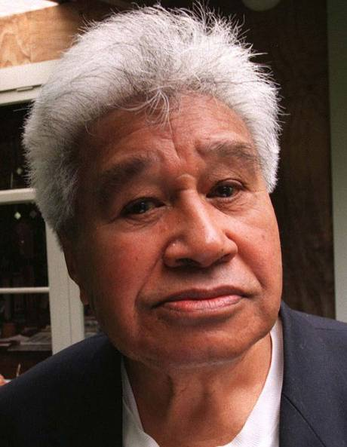
Hone Tuwhare
1922 –2008

Slide 2
Life
Born in Kaipara in 1922. Died in Otago 2008.
Tribal affiliations; Ngapuhi, Ngati Korokoro, Ngati Tautahi, Te Popoto, Uri-O-Hau.
Apprenticed and worked as a boilermaker.
Played a very active role in the Trade Union Movement – eventually kicked out for being a troublemaker.
Began writing poetry seriously at the age of 34.
Introduced a distinct Maori and working-class voice that reshaped Kiwi poetry.
"No Ordinary Sun" was published in 1964 and is still considered one of his most powerful poems.
After the war, he served in Japan with Jayforce (the New Zealand troops that were part of the post-war occupation force in Japan) and saw first-hand the ruination of Hiroshima.

Slide 3
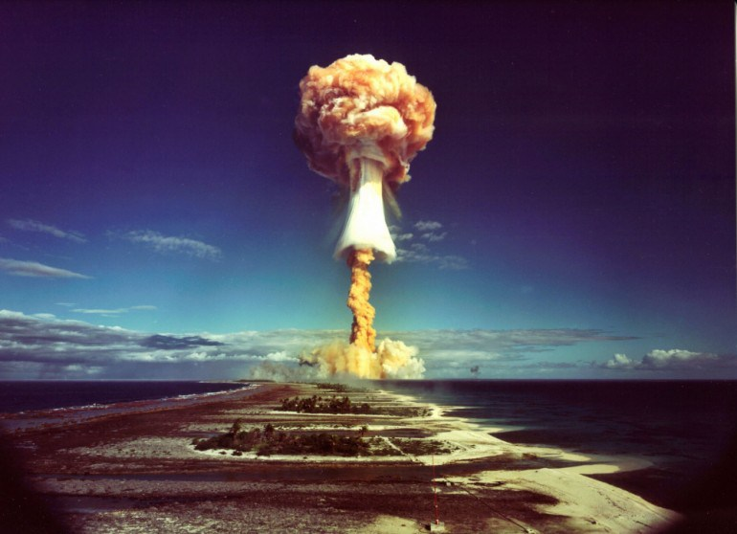
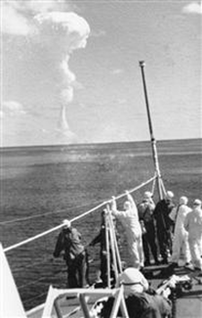
Nuclear Testing in the Pacific
After WW2, the United States, France and British allies, tested nuclear weapons in the Pacific region.
In 1963 the New Zealand, British, American and Soviet governments agreed to ban atmospheric tests.
New Zealand was involved in ongoing protest over French nuclear testing from the mid-1960s when France began testing nuclear weapons in French Polynesia.
A total of 41 atmospheric nuclear tests were conducted at Mururoa between 1966 and 1974

Slide 4
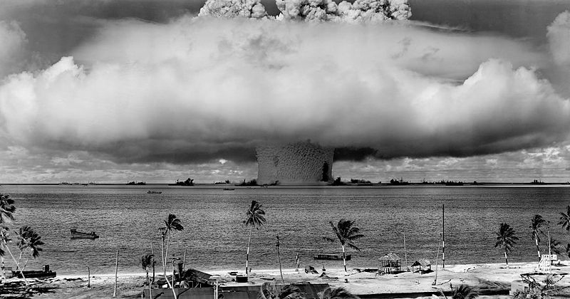
Nuclear test in the Marshall Islands

Slide 5
No Ordinary Sun
Janet Hunt: ‘one of the emblems of the peace movement through the late sixties, the seventies, and eighties’
Tuwhare: ‘the main theme is […] the horror and desolation that an H-bomb would bring, something I feel very strongly[ …] I am aware all the time of the threat that is hanging over our world’
In this poem, Tuwhare draws from at least two cultural traditions that allow us to read the sun/tree relationship as an allegory.
1. Growing up speaking Māori and being exposed to the tradition in which one addresses things such as trees, animals, and features of the landscape, to establish humanity’s genealogical connections to the earth.
2. The influence of the Bible that Tuwhare’s father read to him as a child to help develop his English. We might read this poem as an allegory of Christ, a narrative about the sacrifice of the tree/cross as an attempt to rescue humanity from its sin.

